Slide 1
Unit 4
File Allocation Table

Slide 2
What Is File Allocation Table (FAT)?
A file allocation table (FAT) is a table that an operating system maintains on a hard disk that provides a map of the clusters (the basic units of logical storage on a hard disk) that a file has been stored in.

Slide 3
When we write a new file to a hard disk, the file is stored in one or more clusters that are not necessarily next to each other; they may be rather widely scattered over the disk.
A typical cluster size is 2,048 bytes, 4,096 bytes, or 8,192 bytes.
The operating system creates a FAT entry for the new file that records where each cluster is located and their sequential order.

Slide 4
When we read a file, the operating system reassembles the file from clusters and places it as an entire file where we want to read it.
For example, if it is a long Word Document, it may very well be stored on more than one cluster on our hard disk.

Slide 5
FAT file system is named for its method of organization - the file allocation table.
It is a file system invented by Microsoft in 1977 for disk management, and it is used as the default file system in Windows before the release of NTFS (Windows NT file System).

Slide 6
Most hard drives require a process known as seeking;
This is the actual physical searching and positioning of the read/write head of the drive.
The FAT file system was designed to reduce the amount of seeking and thus minimize the wear and tear on the hard disc.

Slide 7
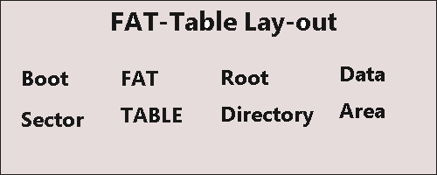
A FAT file system has four different sections, each as a structure in the FAT partition.

Slide 8
The four sections are:
Boot Sector: This is also known as the reserved sector; it is located on the first part of the disc. It contains: the OS's necessary boot loader code to start a PC system, the partition table known as the master boot record (MBR) that describes how the drive is organized, and the BIOS parameter block (BPB) which describes the physical outline of the data storage volume.

Slide 9
FAT Region: This region generally encompasses two copies of the File Allocation Table which is for redundancy checking and specifies how the clusters are assigned.

Slide 10
Root Directory Region: This region is a directory table that contains the information about the directories and files.

Slide 11
Data Region: This is where the directory data and existing files are stored. It uses up the majority of the partition.

Slide 12
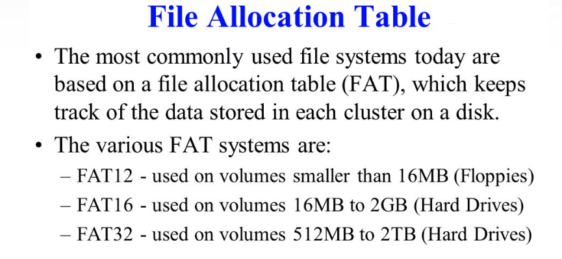

Slide 13
file allocation table is a list of clusters to show where the stored data is.
The general types of file system (FAT12, FAT16 or FAT32) are determined by the width of the cluster entries in the FAT.

Slide 14
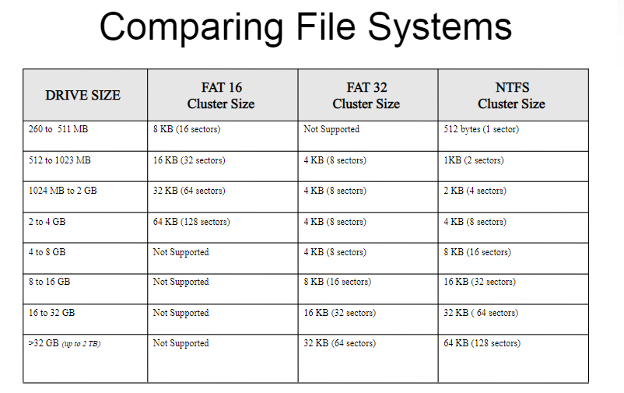

Slide 15
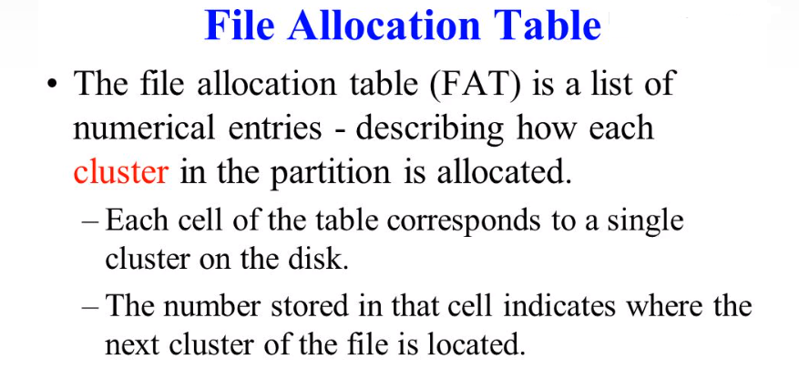

Slide 16
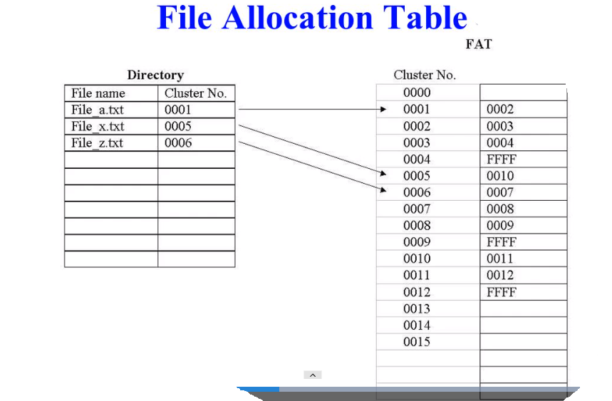

Slide 17
No of Clusters in FAT16 and FAT32

Slide 18
A cluster is equal to one or more 512-byte sectors, in a power of two.
Having more than one sector per cluster reduces the size and processing overhead of the FAT and enables the operating system to run faster because it has fewer individual units to manage.

Slide 19
FAT16 - Number of Clusters
FAT16 uses 16-bit entries to reference the clusters in the partition,
So there can be a maximum of only 2 ¹⁶ Clusters= 65,536 clusters.

Slide 20
e.g., a 500MB partition will have cluster of size:
= 500MB / 65,536
= 512000 kB / 65,536
= 7.8125 kB
The cluster size will be multiples (1, 2, 4, 8, 16, 32, 64) of 512 Bytes.
So, the cluster size will 16 x 512 Bytes = 8kB.

Slide 21
FAT32 - Number of Clusters
FAT32 uses 32-bit entries to reference the clusters in the partition,
But there are a maximum of only
2²⁸= 268,435,456 clusters.

